Slide 1
Data Visualization on Bank Credit Score
Yu Wen

Slide 2
Outline
Dataset
Questions
NLQ
Top 3 Drivers
Rules for predictions
5 charts
Dashboard

Slide 3
Dataset
Bank Credit score

Slide 4
Questions
Analysis of the descriptive question
What kind of people will have better credit score?
What is the relationship between number of loans held by people and credit score?
Analysis of the predictive question
How many loans are people likely to have given the period people holding the loan.

Slide 5
NLQ
Number of delayed payment and outstanding debit by credit score.
Number of credit card by credit score.
Credit score hierarchy colored by monthly balance and sized by num of loan.
Num of loan by credit history age
Average annual income by credit score

Slide 6
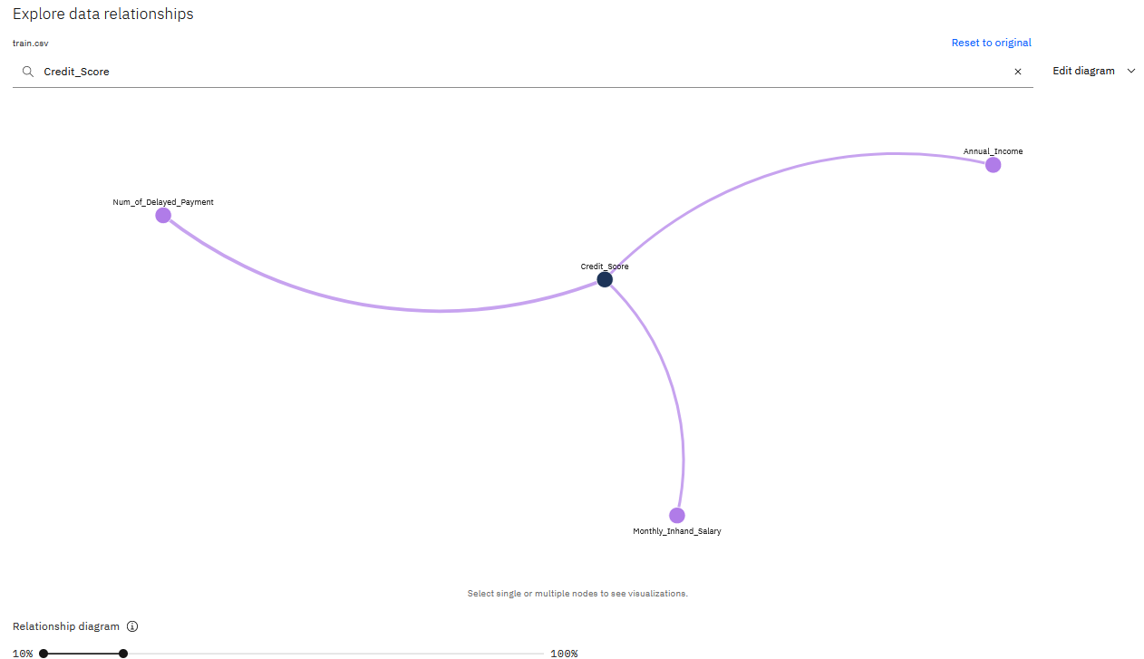
Top 3 drivers: Num_of_Delayed_Payment Annual_Income Monthly_Inhand_Salary

Slide 7
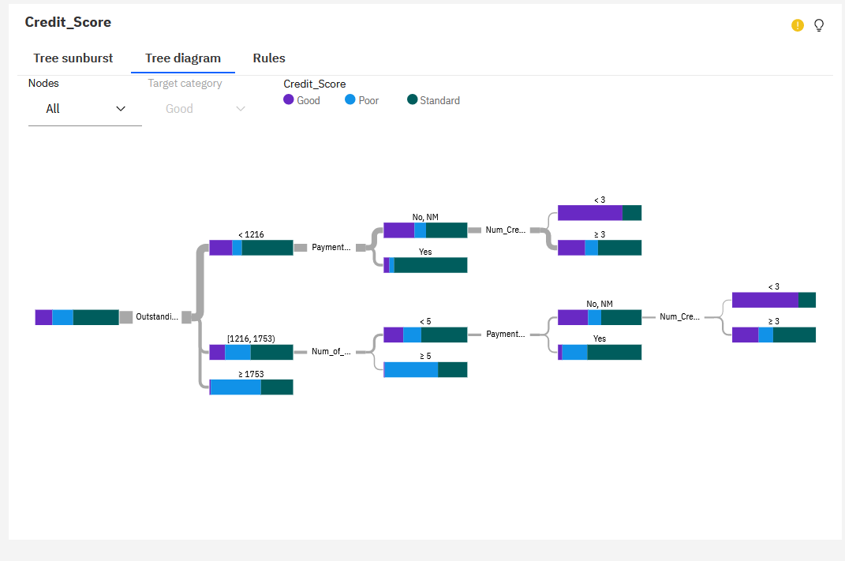
Decision Tree

Slide 8
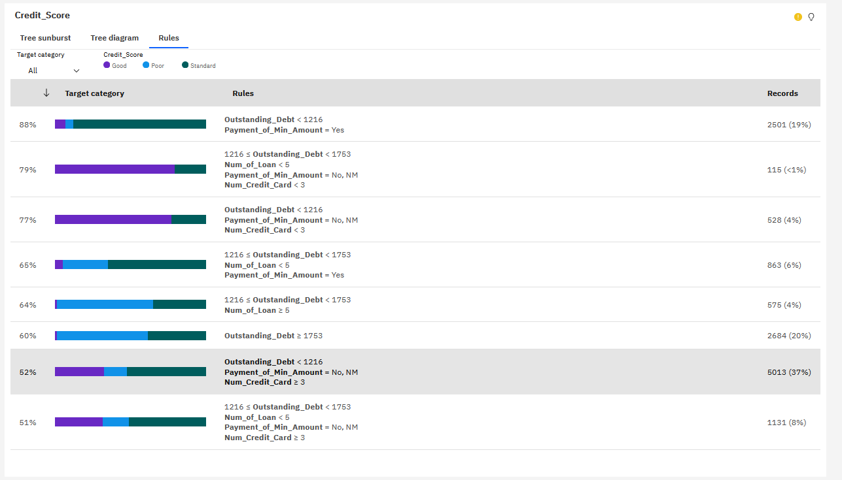
Rules for predictions

Slide 9
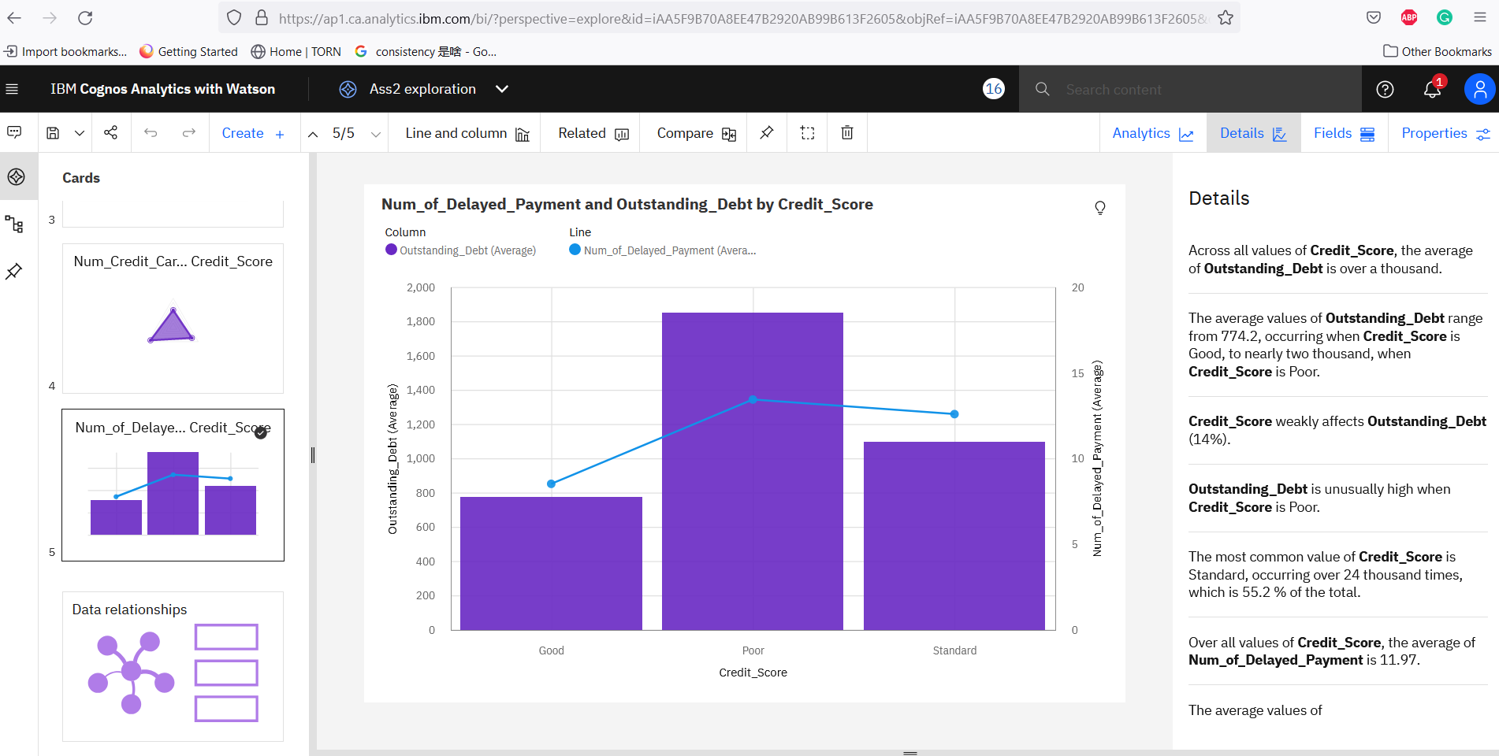

Slide 10
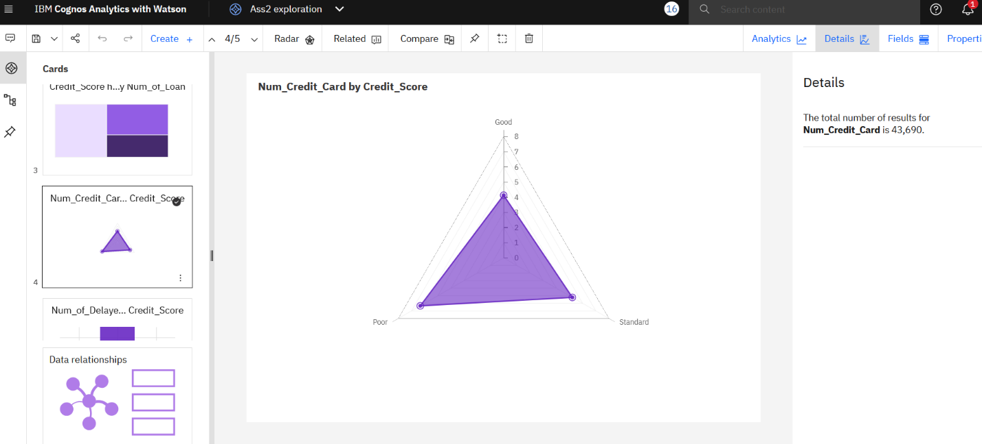

Slide 11
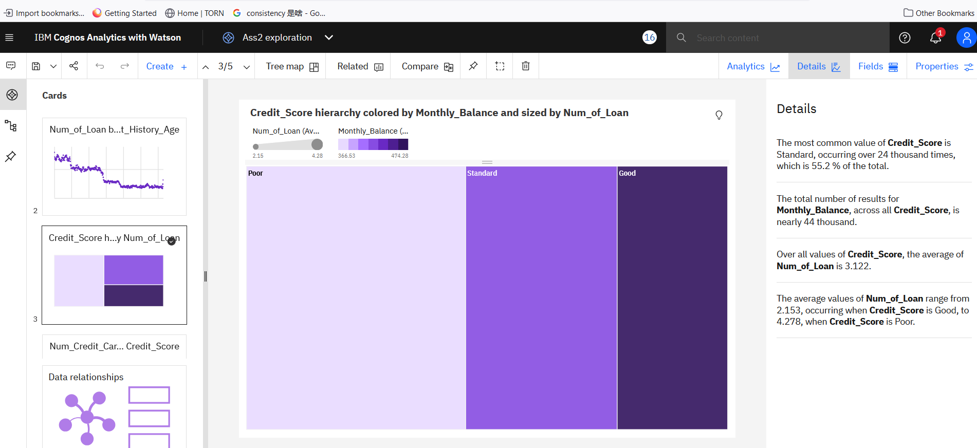

Slide 12
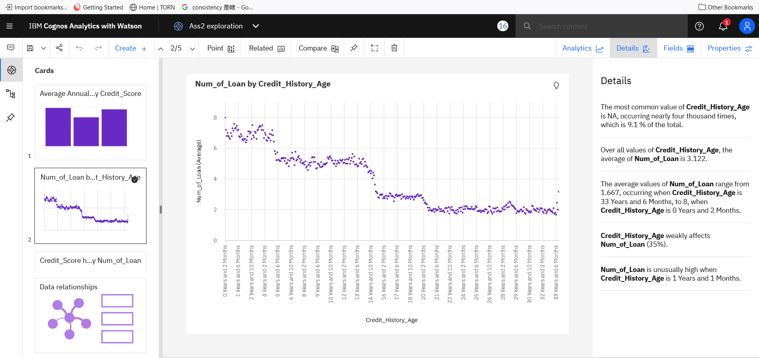

Slide 13
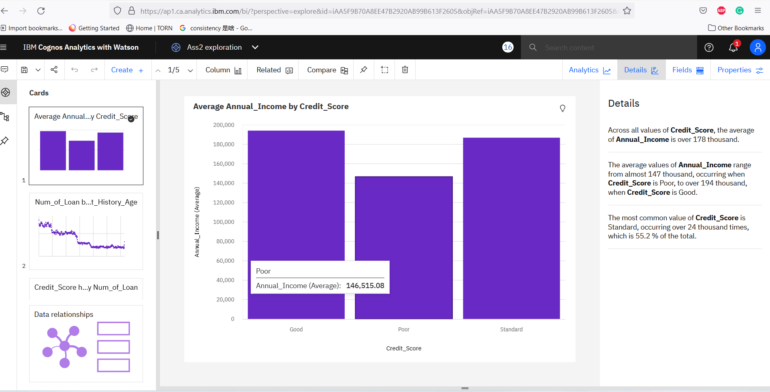

Slide 14
Conclusion

